Slide 1


Batın Ö.
13.09.2023

Slide 2

Outline
Executive Summary
Introduction
Methodology
Results
Conclusion
Appendix

Slide 3
Executive Summary
"Analyzing SpaceX Data for Successful Landings
Collected data from SpaceX API and Wikipedia.
Created 'class' labels for successful landings.
Explored data with SQL, visualizations, maps, and dashboards.
Engineered features and applied one-hot encoding.
Standardized data and optimized models using GridSearchCV.
Visualized model accuracy.
Results:
Four ML models: Logistic Regression, Support Vector Machine, Decision Tree, K Neighbors.
All achieved ~83.33% accuracy.
Models tended to overpredict success.
More data needed for improved accuracy.

Slide 4
Introduction
Background:
The Commercial Space Age is Thriving
SpaceX Leads with Competitive Pricing ($62 million vs. $165 million USD)
SpaceX's Success Attributed to Rocket Recovery (Stage 1)
Space Y Aims to Challenge SpaceX
Problem:
Space Y Entrusts Us with Training a Machine Learning Model for Predicting Successful Stage 1 Rocket Recovery

Slide 5

Section 1

Slide 6
Methodology
Data Collection & Analysis Process:
Gathered data from SpaceX API and Wikipedia
Cleaned and organized the data
Identified successful and unsuccessful landings
Explored data with visuals and SQL
Created interactive visuals with Folium & Plotly Dash
Predictive analysis using classification models
Fine-tuned models with GridSearchCV

Slide 7
Data Collection
Data collection involved two methods: API Requests and Web Scraping.
API Requests: Gathered data from SpaceX's public API.
Web Scraping: Extracted data from a table in SpaceX's Wikipedia entry.
SpaceX API Data Columns: FlightNumber, Date, BoosterVersion, PayloadMass, Orbit, LaunchSite, Outcome, Flights, GridFins, Reused, Legs, LandingPad, Block, ReusedCount, Serial, Longitude, Latitude
Wikipedia Web Scraping Data Columns: Flight No., Launch Site, Payload, Payload Mass, Orbit, Customer, Launch Outcome, Version Booster, Booster Landing, Date, Time

Slide 8
Data Collection – SpaceX API
Github:
https://github.com/batinium/applied-data-science-capstone/blob/main/ADSC_1_jupyter_labs_spacex_data_collection_api.ipynb
.JSON file + Lists(Launch Site, Booster Version, Payload Data)
Json_normalize to DataFrame data from JSON
Request (Space X APIs)
Filter data to only include Falcon 9 launches
Fill missing PayloadMass values with mean
Cast dictionary to a DataFrame
Dictionary relevant data

Slide 9
Data Collection - Scraping
Github
https://github.com/batinium/applied-data-science-capstone/blob/main/ADSC-2-jupyter_labs_webscraping.ipynb
BeautifulSoup
html5lib Parser
Request Wikipedia
html
Find launch info html table
Create dictionary
Cast dictionary to DataFrame
Iterate through table cells to extract data to dictionary

Slide 10
Data Wrangling
Objective: Create a training label for landing outcomes, where success is represented as '1' and failure as '0'.
Outcome Components:
'Mission Outcome'
'Landing Location'
New Training Label Column: 'class'
Value Mapping:
If 'Mission Outcome' is True: 'Landing Location' True ASDS, True RTLS, & True Ocean → Set 'class' to 1
If 'Mission Outcome' is False: 'Landing Location' None None, False ASDS, None ASDS, False Ocean, False RTLS → Set 'class' to 0
Github: https://github.com/batinium/applied-data-science capstone/blob/main/ADSC_2_1data_wrangling_.ipynb

Slide 11
EDA with Data Visualization
Exploratory Data Analysis (EDA) focused on key variables: Flight Number, Payload Mass, Launch Site, Orbit, Class, and Year. Various plots, including scatter plots, line charts, and bar plots, were employed to assess relationships among these variables. This analysis aimed to identify any meaningful associations that could be leveraged for machine learning model training.
Github: https://github.com/batinium/applied-data-science-capstone/blob/main/ADSC_4_EDA_with_Visualization.ipynb

Slide 12
EDA with SQL
Loaded data into IBM DB2 Database, queried with SQL Python integration to understand launch site names, mission outcomes, customer payload sizes, booster versions, and landing outcomes.
Github: https://github.com/batinium/applied-data-science-capstone/blob/main/ADSC_3_sql_coursera_sqllite.ipynb

Slide 13
Build an Interactive Map with Folium
Using Folium maps, we visually display Launch Sites, both successful and unsuccessful landings, and their proximity to important landmarks such as Railway, Highway, Coast, and City. This helps us comprehend the rationale behind the choice of launch site locations and provides a clear visualization of successful landings in relation to these key points.
Github: https://github.com/batinium/applied-data-science-capstone/blob/main/ADSC_5_Interactive_Visual_Analytics_with_Folium.ipynb

Slide 14
Build a Dashboard with Plotly Dash
Dashboard Overview:
Key Visuals: Pie Chart and Scatter Plot.
Pie Chart: Choose between overall launch site success distribution or individual site success rates.
Scatter Plot: Options to display data for all launch sites or specific sites, with payload mass adjustable from 0 to 10,000 kg.
Usage:
Pie Chart: Visualizes launch site success rates.
Scatter Plot: Helps analyze success variations across launch sites, payload mass, and booster version categories.
Github: https://github.com/batinium/applied-data-science-capstone/blob/main/ADSC_6_Machine_Learning_Prediction.ipynb

Slide 15
Predictive Analysis (Classification)
Fit and Transform
Github: https://github.com/batinium/applied-data-science-capstone/blob/main/ADSC_6_Machine_Learning_Prediction.ipynb
Features using
Score models on
Split label column
split test set
‘Class’ from dataset
Standard Scaler
Use GridSearchCV
Barplot to compare scores of models
on LogReg, SVM,
Decision Tree, and
KNN models
Train_test_split
GridSearchCV
(cv=10) to find optimal parameters
Confusion Matrix
data
for all models

Slide 16
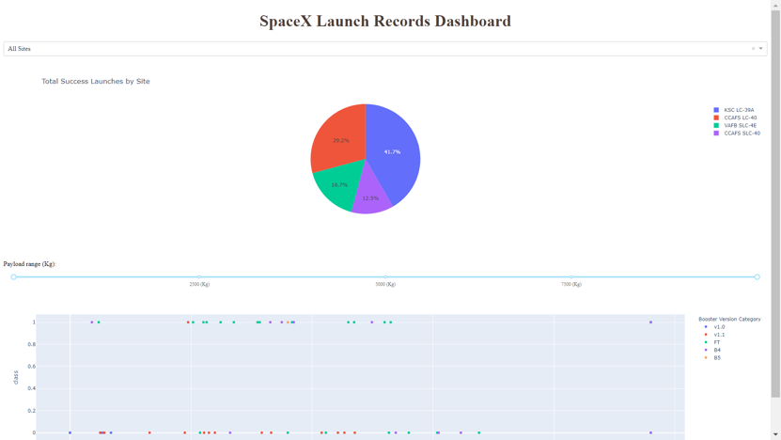
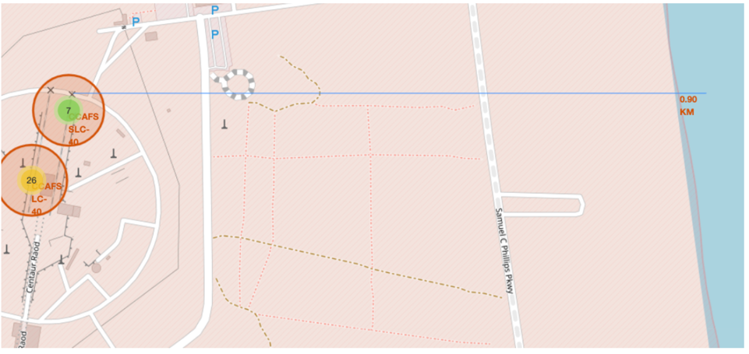
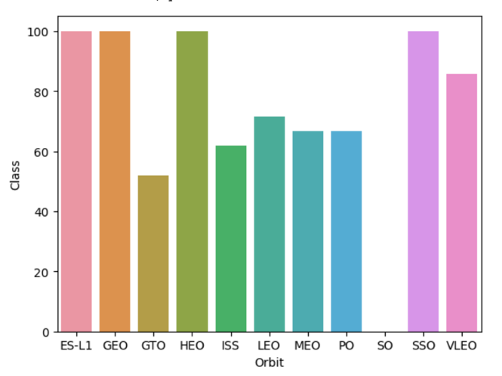
Results
This serves as an introductory glimpse into the forthcoming Plotly dashboard, offering a sneak peek at its various components. Within this dashboard, you can expect to find informative sections dedicated to Exploratory Data Analysis (EDA) presented through dynamic visualizations, EDA enriched with SQL insights, an Interactive Map powered by Folium, and culminating with the unveiling of our model's performance metrics, boasting an impressive accuracy rate of approximately 83%.

Slide 17

Section 2

Slide 18
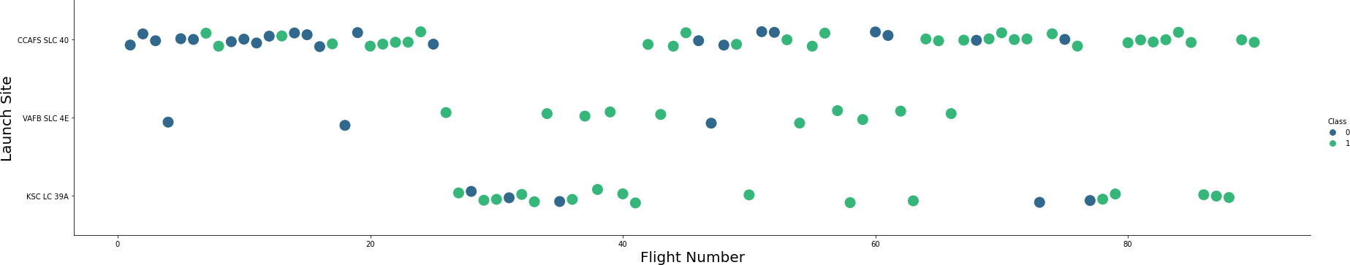
Flight Number vs. Launch Site
The colors on the graphic convey information about rocket launches. Green means a launch was successful, while purple means it was not.
The graph also shows that the success rate of launches has been improving as the flight number increases. There seems to be a notable improvement in success around flight number 20, which was likely a significant breakthrough.
The launch site at CCAFS appears to be the busiest, with the most launches happening there.

Slide 19
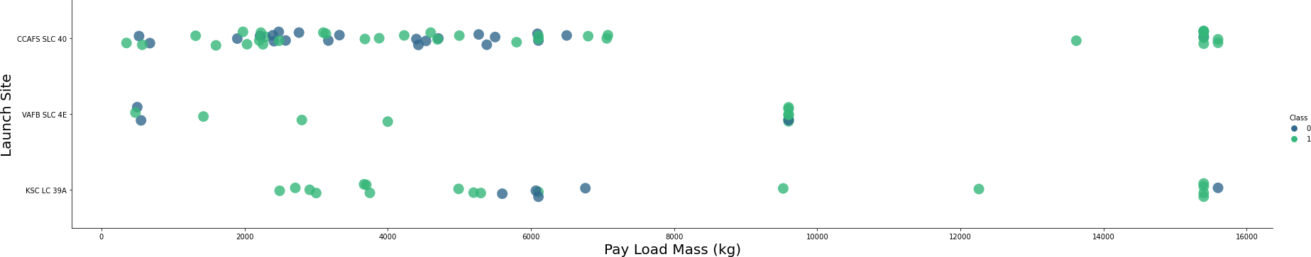
Payload vs. Launch Site
Green means the launch was successful, while purple means the launch was unsuccessful.
The weight of the payload typically ranges from 0 to 6000 kilograms. Additionally, various launch sites have different payload weight requirements.

Slide 20
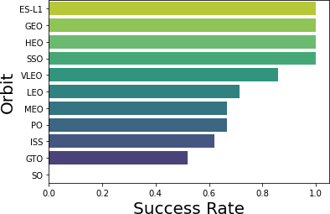
Success Rate vs. Orbit Type
ES-L1 (1), GEO (1), and HEO (1) missions have a 100% success rate, with each having only one mission attempt (sample sizes in parentheses).
SSO (5) missions also have a 100% success rate, but there have been a total of five mission attempts in this category.
VLEO (14) missions have a decent success rate and have been attempted 14 times.
SO (1) missions have a 0% success rate, with one mission attempt resulting in failure.
GTO (27) missions have an approximately 50% success rate, making it the category with the largest number of mission attempts, totaling 27.

Slide 21
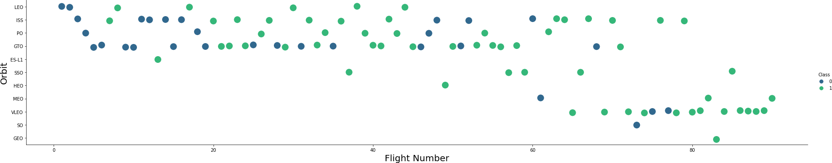
Flight Number vs. Orbit Type
Green means a successful launch, while purple signifies an unsuccessful one.
SpaceX's choice of launch orbit has shifted as they've conducted more flights. It seems that the success of their launches is linked to this choice.
Initially, SpaceX used Low Earth Orbit (LEO) for their launches and had moderate success. However, in their recent launches, they've returned to Very Low Earth Orbit (VLEO). It appears that SpaceX tends to perform better in lower orbits or orbits that are synchronized with the Sun's position.

Slide 22
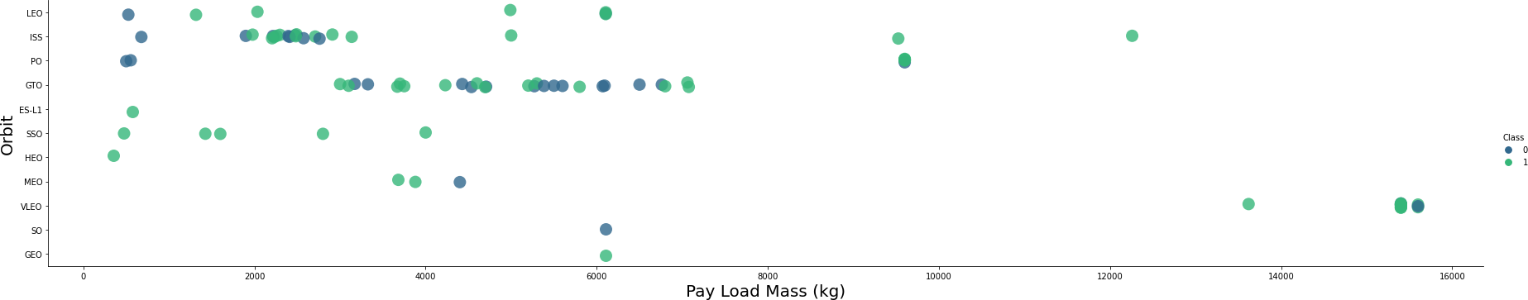
Payload vs. Orbit Type
When we look at the color codes, green means a successful launch, while purple indicates an unsuccessful one.
It appears that the weight of the payload is connected to the type of orbit achieved. For orbits like Low Earth Orbit (LEO) and Sun-Synchronous Orbit (SSO), we often see relatively light payloads. However, when it comes to Very Low Earth Orbit (VLEO), the most successful orbits tend to have heavier payload masses, typically on the higher side of the range.

Slide 23
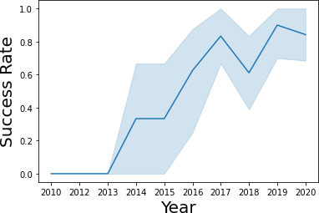
Launch Success Yearly Trend
Success has generally been on the rise since 2013, with a small decrease in 2018. In recent years, the success rate has remained consistently around 80%.

Slide 24
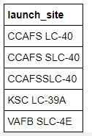
All Launch Site Names
I want to retrieve the names of unique launch sites from the database. It appears that 'CCAFS SLC-40' and 'CCAFSSLC-40' likely refer to the same launch site due to data entry errors. The previous name for this site was 'CCAFS LC-40.' So, there are likely only three unique launch site values: 'CCAFS SLC-40,' 'KSC LC-39A,' and 'VAFB SLC-4E.

Slide 25
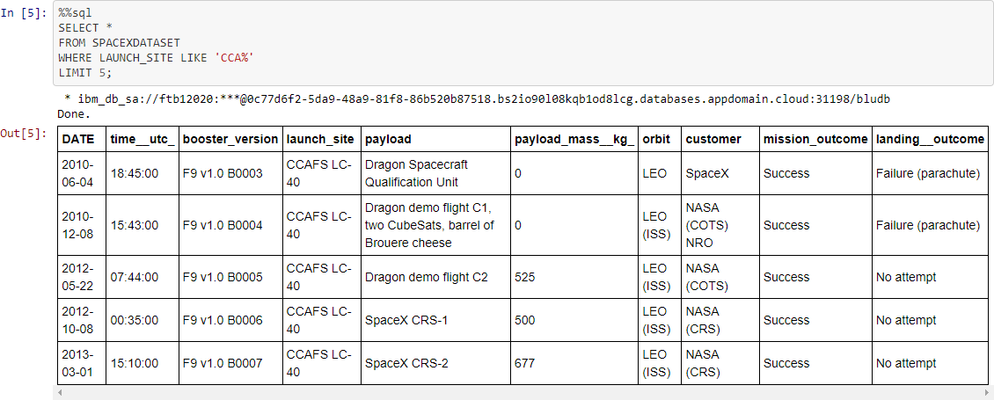
Launch Site Names Begin with 'CCA'
First five entries in database with Launch Site name beginning with CCA.

Slide 26
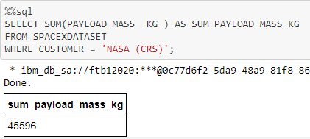
Total Payload Mass
This query calculates the combined weight of payloads in kilograms that were transported to the International Space Station (ISS) when NASA was the customer. The term 'CRS' stands for Commercial Resupply Services, which signifies that these payloads were delivered to the ISS.

Slide 27
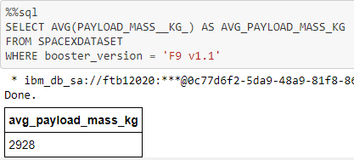
Average Payload Mass by F9 v1.1
This query is used to find the average weight of payloads carried by launches that utilized the booster version known as "F9 v1.1." The average payload mass for the F9 1.1 booster falls towards the lower end of our payload weight range.

Slide 28
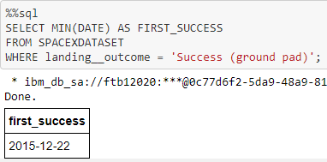
First Successful Ground Landing Date
This query provides information about the date of the first successful ground pad landing. The first successful ground pad landing did not occur until the end of 2015. In general, successful landings began to occur in 2014.

Slide 29
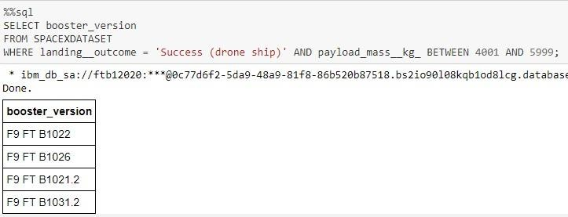
Successful Drone Ship Landing with Payload between 4000 and 6000
This query will provide a list of four booster versions that both successfully landed on a drone ship and had a payload mass within the range of 4000 to 6000, excluding the exact values of 4000 and 6000.

Slide 30
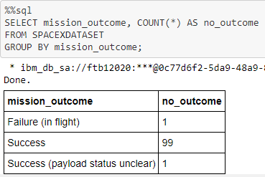
Total Number of Successful and Failure Mission Outcomes
This statement discusses the results of a query related to SpaceX missions. It reveals that SpaceX has a very high success rate, achieving its mission objectives in nearly 99% of cases. This suggests that most of the times when a mission doesn't go as planned, it's actually intentional, possibly for testing or other reasons. Interestingly, there is one mission with an uncertain payload status, and unfortunately, there was one mission that failed during its flight.

Slide 31
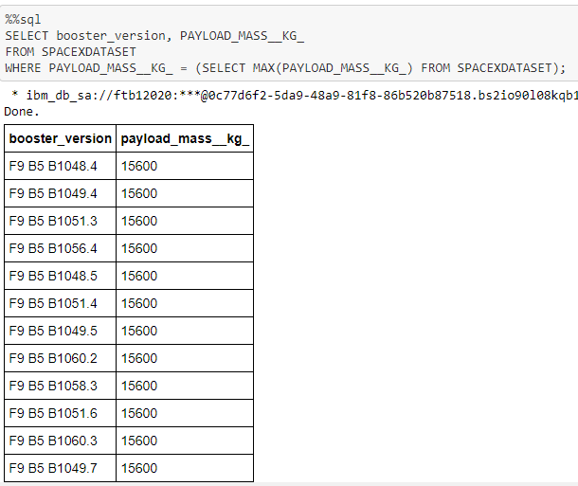
Boosters Carried Maximum Payload
This query provides information about booster versions and their relationship to payload mass. It tells us that the query is looking for booster versions that were used to carry the highest payload mass, which was 15600 kg. These booster versions all belong to a category known as "F9 B5 B10xx.x." The fact that these booster versions are very similar suggests that there is a correlation between the payload mass and the specific booster version used. In other words, it seems that the choice of booster version is influenced by the weight of the payload it needs to carry.

Slide 32
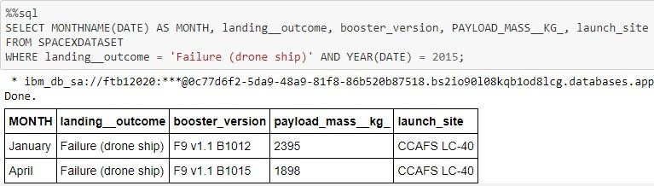
2015 Launch Records
This query fetches information about SpaceX launches that took place in 2015 and meets the following criteria: the first stage of the rocket failed to land on a drone ship. The information retrieved includes the month of the launch, the outcome of the landing attempt, the version of the booster used, the mass of the payload in kilograms, and the launch site. There were two instances in 2015 where this specific situation occurred.

Slide 33
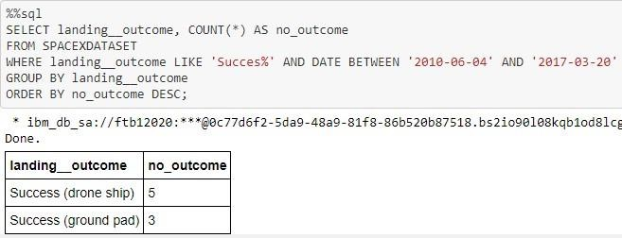
Rank Landing Outcomes Between 2010-06-04 and 2017-03-20
This query provides a list of successful rocket landings that occurred between June 4, 2010, and March 20, 2017. Successful landings are categorized into two types: drone ship landings and ground pad landings. In total, there were 8 successful landings during this specified time frame.

Slide 34

Section 3

Slide 35
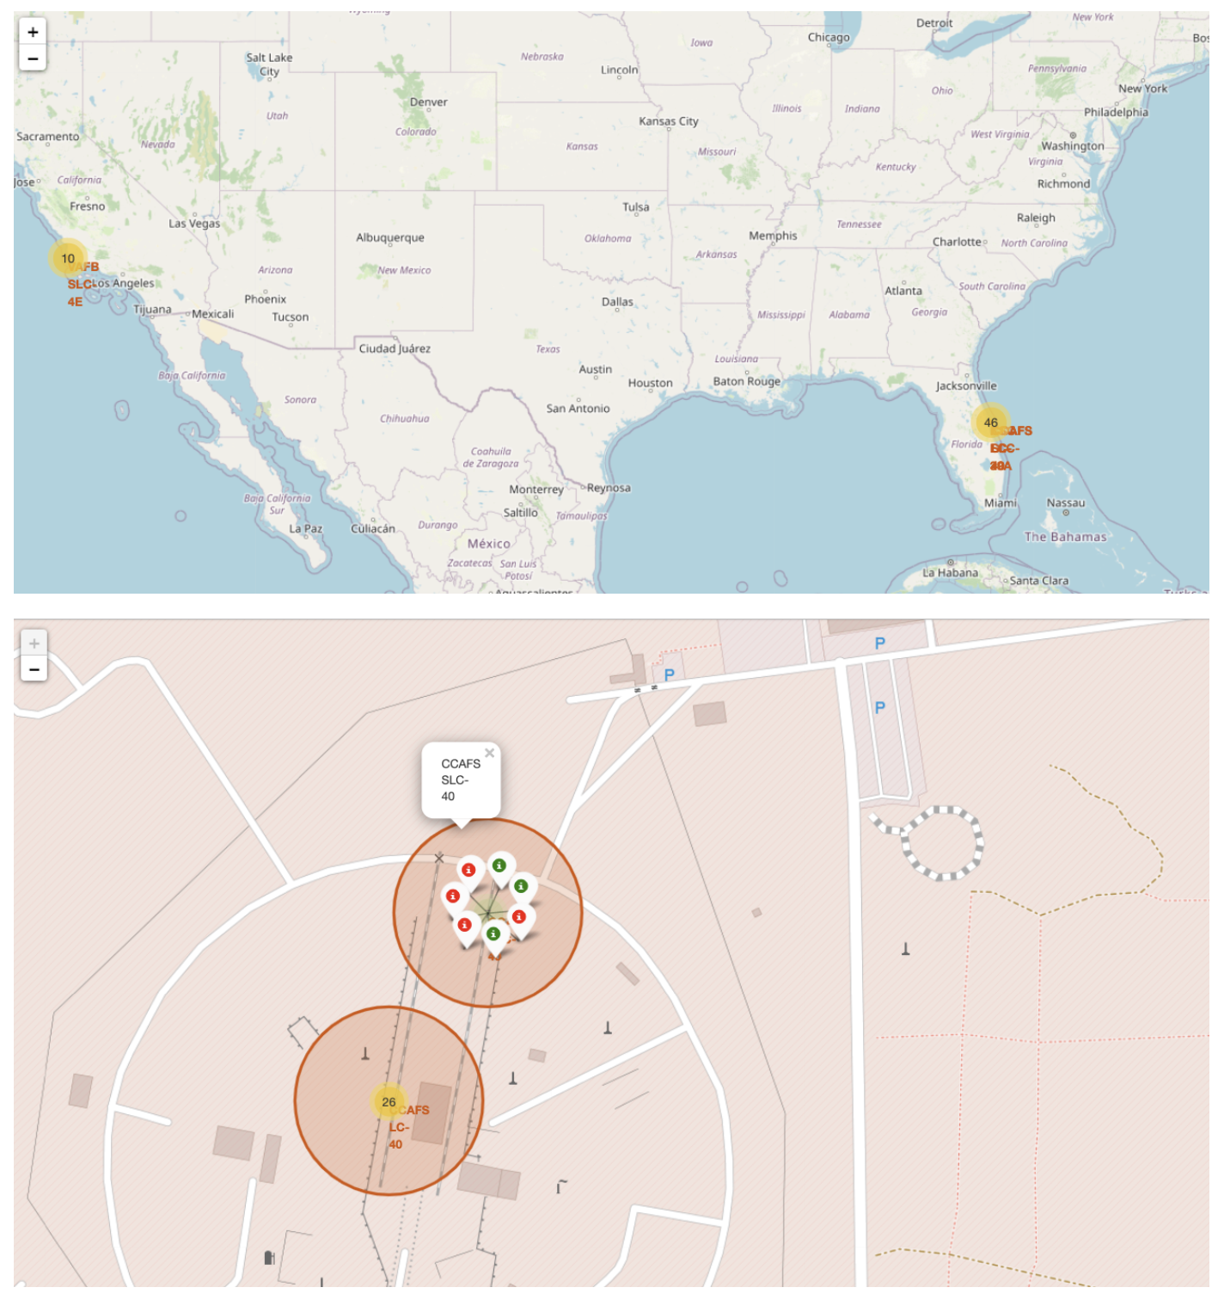
<Launch Site>
The map displays all the launch sites in relation to the entire United States. We also have a closer view of the two launch sites in Florida, which are situated very close to each other. It's important to note that all of these launch sites are located near the ocean.

Slide 36
Landings
You can click on the clusters on the Folium map to see information about each landing. Successful landings are represented by green icons, while failed landings are represented by red icons. For instance, in the case of VAFB SLC-4E on this map, there are 4 successful landings and 6 failed landings.

Slide 37
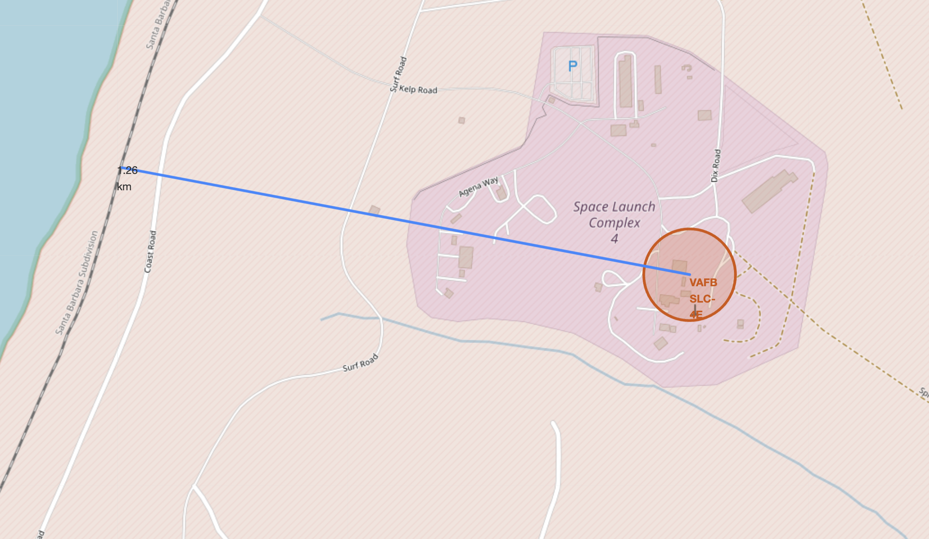
Launch Site Approximation
Let's take KSC LC-39A as an example. Launch sites, like this one, are strategically located near railways for easy transportation of large equipment and supplies. They are also situated close to highways for the convenience of transporting both people and supplies.
Additionally, launch sites are positioned near coastal areas and away from densely populated cities. This arrangement is designed to ensure that if there's a problem during a rocket launch, and the rocket needs to be aborted, it can safely fall into the sea instead of landing in a heavily populated area.

Slide 38

Section 4

Slide 39


Successful Launches
This chart shows the number of successful rocket landings at different launch sites. CCAFS LC-40 used to be called CCAFS SLC-40, so CCAFS and KSC have the same number of successful landings, but most of these happened before the name change. VAFB has the fewest successful landings, possibly because it has a smaller number of launches and launching rockets on the west coast is more challenging.

Slide 40

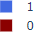
Success Rate of Launch Site
KSC LC-39A has the highest success rate with 10 successful landings and 3 failed landings.

Slide 41

Payload Mass, Success and Booster Version
The Plotly dashboard has a feature called the "Payload range selector," which allows you to choose a range of payload values. However, the default range is set from 0 to 10,000, even though the maximum payload capacity is 15,600.
In the context of the data, there's a classification system where "1" indicates a successful landing, and "0" represents a failure. The scatter plot on the dashboard also takes into account the booster version category by using different colors, and it adjusts the size of the data points based on the number of launches.
What's interesting is that within the range of 0 to 6,000 on the dashboard, there are two instances where there were failed landings, and the payloads for these failed landings were zero kilograms.

Slide 42

Section 5

Slide 43

Classification Accuracy
All the models achieved nearly identical accuracy scores of 83.33% on the test dataset. It's important to mention that the test dataset is quite small, consisting of only 18 samples. This limited sample size can lead to significant fluctuations in accuracy results, especially in models like the Decision Tree Classifier when running multiple times. To make a more confident determination about the best model, it is likely that we need a larger amount of data.

Slide 44

Confusion Matrix
In the context of predictions, correct outcomes are aligned along a diagonal line from the top-left corner to the bottom-right corner.
In our case, all the models we tested performed equally on the test dataset, so their confusion matrices (a way to assess prediction performance) are identical. Specifically:
All the models correctly predicted 12 successful landings when the actual label indicated a successful landing.
They also correctly predicted 3 unsuccessful landings when the true label was indeed an unsuccessful landing.
However, the models made a mistake in predicting 3 successful landings when, in reality, the landings were unsuccessful (these are called false positives). This suggests that our models tend to overestimate the number of successful landings.

Slide 45
Conclusions
Our task was to build a machine learning model for Space Y, a company competing with SpaceX. The purpose of this model is to predict when the first stage of a rocket will successfully land, which can save Space Y approximately $100 million USD.
To develop this model, we gathered data from a public SpaceX API and also collected information by scraping SpaceX's Wikipedia page. We then organized this data, created labels for it, and stored it in a DB2 SQL database. To make the insights more accessible, we designed a dashboard for visualization.
The machine learning model we constructed achieved an accuracy rate of 83%. This means that Allon Mask, the CEO of SpaceY, can use this model to make relatively accurate predictions about whether a launch will result in a successful Stage 1 landing before the actual launch takes place. This information can help SpaceY decide whether to proceed with the launch or not.
To further enhance the model's performance, it is advisable to gather more data. Additional data can aid in identifying the most effective machine learning model and ultimately improving the accuracy of the predictions.

Slide 46
Appendix
Github: https://github.com/batinium/applied-data-science-capstone/tree/main
This project was made possible with https://www.coursera.org/search?query=IBM%20applied%20data%20capstone&

Slide 47


